Slide 1
BOSTON IT SOLUTION INDIA PRIVATE LIMITED
“EMOTIONAL EXAMIINATION OF AMAZON FOOD REVIEW”
SUPERVISED BY
Dr.S.VINOTH KUMAR M.E.,PhD
ASSOCIATE PROFESSOR
PRESENTED BY
1. SRESHTHA SAHA (11847)(19UECS0930)
2. S.NAVEEN (15324)(19UECS0874)
3. V.AKHIL SAI (15775)(19UECS1019)

Slide 2
INDUSTRY DETAILS
Industry Name: Boston IT Solution India PVT LTD,Bangalore.
Institute Name : Vel Tech Rangarajan Dr. Sagunthala R&D Institute of Science and Technology.
Duration of Internship: (20/01/23 – 25/05/23)
Duration of Internship in Months: 05
Industry Guide Name: Raakesh Kumar
Industry Guide Mobile No :7200522189
Industry Guide Mail ID : sriraakesh.kumar@bostonindia.in
Industry Address : Bangalore

Slide 3
ABSTRACT
The main aim of this study is to examine the emotional aspects of Amazon food reviews and gain insights into the language used by reviewers.
The study utilizes sentiment analysis to analyze a dataset of food reviews from Amazon, with a focus on the emotional tone of the language used.
The analysis reveals that reviewers use various emotions to express their food experiences, with positive emotions like joy, satisfaction, and excitement being the most common.
Negative emotions such as disappointment and frustration are also present but less frequent.
The study concludes that emotional language is significant in shaping consumers' perceptions of food products and that understanding consumer emotional responses can assist businesses in better catering to their preferences and needs.

Slide 4
OBJECTIVES
This study aims to examine the emotional aspects of Amazon food reviews to obtain a better understanding of the language used by reviewers.
The analysis will focus on the emotional tone of the reviews and seek to identify the various emotions that consumers express when discussing food products, as well as how these emotions might affect their perceptions and buying behavior.
The study's ultimate goal is to provide businesses with valuable insights into consumer emotions and how they can use this information to improve customer satisfaction and loyalty.
This research aims to explore the occurrence of positive and negative emotions in Amazon food reviews and investigate their associations with different food products.
The study also seeks to identify potential trends and patterns in the emotional expressions used by reviewers across diverse demographic groups.

Slide 5
INTRODUCTION
Food is a fundamental aspect of human life and is often associated with emotional experiences. Online food reviews have become a critical source of information for customers who want to make informed decisions about what to buy and where to eat.
With the increasing popularity of online food ordering and delivery platforms like Amazon, it has become essential for businesses to comprehend the emotional responses of customers towards food products, in order to improve their services and enhance customer satisfaction.
Therefore, this study aims to examine the emotional language used by reviewers in Amazon food reviews to gain insights into the range of emotions that customers associate with food products.
The study employs sentiment analysis to analyze a dataset of food reviews from Amazon. By understanding the emotional responses of customers, businesses can better cater to their preferences and needs, thereby improving their brand loyalty.

Slide 6
INTRODUCTION
Additionally, the study aims to identify potential patterns and trends in the emotional language used by reviewers from diverse demographic groups. This can provide business with valuable insights into consumer emotions and preferences, enabling them to improve their products and services, increase customer satisfaction, and enhance their brand image.
This study contributes to a better understanding of the role of emotional language in shaping customers perceptions of food products and its significance for business operating in the food industry.

Slide 7
DESIGN AND METHODOLOGIES
MODULE 1: Data Collection and Pre-processing
MODULE 2: Sentiment Analysis
MODULE 3: Data Analysis
MODULE 4: Recommendations

Slide 8
STANDARDS & POLICIES
Python Standard Used: ISO/IEC WD TR 24772-4
Anaconda-Standard Used: ISO/IEC 10918-1:1994

Slide 9
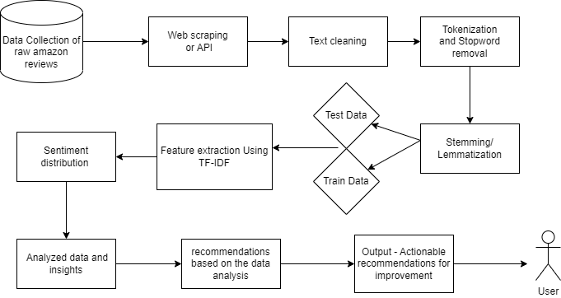
IMPLEMENTATION
ARCHITECTURE DIAGRAM

Slide 10
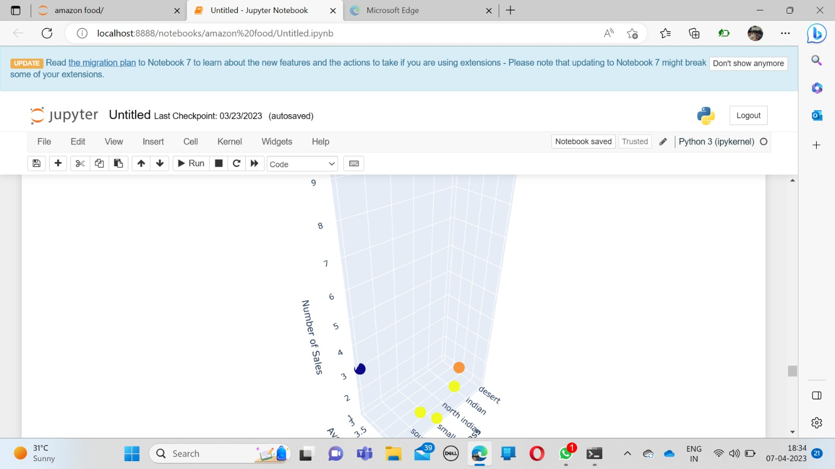
TESTING
UNIT TESTING
Test Result

Slide 11
Test Result
The term ”unit testing” refers to a specific kind of software testing in which discreteof a program are investigated. The purpose of this testing is to ensure that the software operates as expected.
INPUT
1. Test case for preprocessing: Ensure that the text preprocessing module correctly
removes stop words, punctuation, and numbers from the text.
2. Test case for aspect-based sentiment analysis: Ensure that the aspect-based
sentiment analysis module correctly identifies the aspect of the food being reviewed
and assigns a sentiment to that aspect.
3. Test case for emotion recognition: Ensure that the emotion recognition module
correctly identifies the emotions expressed in the review, such as happiness, sadness,
anger, or fear

Slide 12
INTEGRATION TESTING
The programme is put through its paces in its final form, once all its parts have been combined, during the integration testing phase. At this phase, we look for place where interactions between components might cause problems.
INPUT
1. Test case for data integration: Ensure that the data from multiple sources, such
as the review data, product data, and customer data, are integrated correctly and ac_x0002_curately.
2. Test case for module integration: Ensure that the individual modules of the
system, such as preprocessing, aspect-based sentiment analysis, and emotion recog_x0002_nition, are integrated correctly and are able to work together seamlessly.
3. Test case for output integration: Ensure that the output of the system, such as
sentiment analysis and emotion recognition, is integrated correctly and provides a
comprehensive analysis of the review.

Slide 13
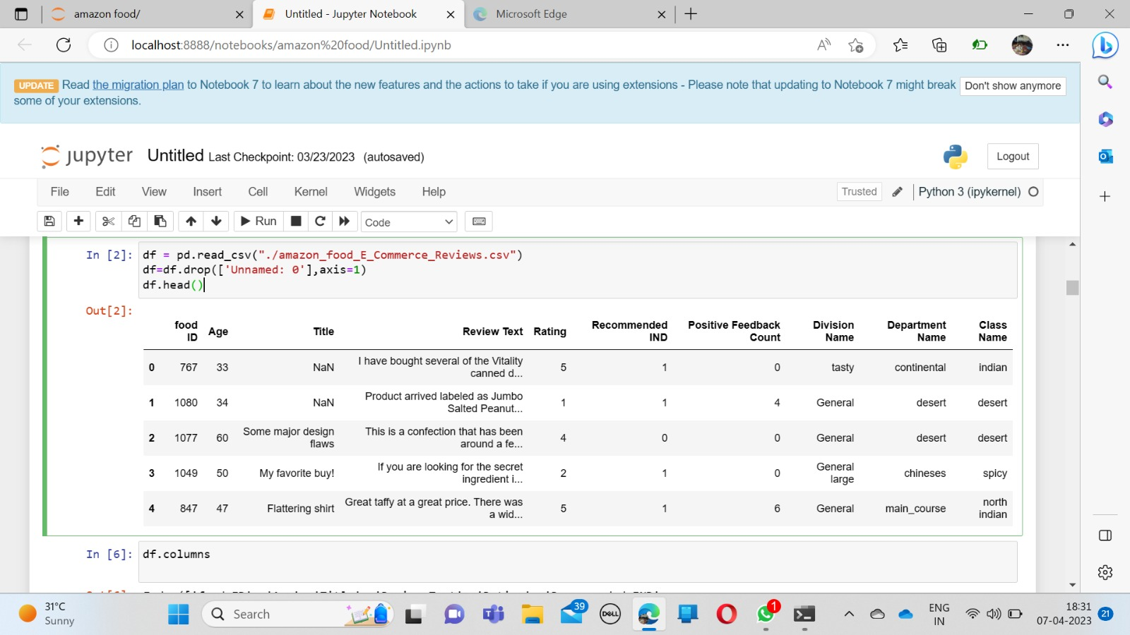
TEST RESULT

Slide 14
SYSTEM TESTING
System testing is performed to ensure the overall functionality and quality of a soft_x0002_ware system or application. The overall system is checked rather than its individual components. Before to being put into a production environment, a system must be put through a battery of tests meant to reveal any flaws in its behaviour or perfor_x0002_mance.
INPUT
1. Test case for overall accuracy: Ensure that the overall accuracy of the system is above a certain threshold, such as 80%, indicating that the system is correctly identifying the sentiment and emotions expressed in the reviews.
2. Test case for performance: Ensure that the system is able to analyze a large volume of reviews within a reasonable amount of time, without any errors or crashes.
3. Test case for real-time analysis: Ensure that the system can analyze reviewsin real-time, enabling Amazon to identify emerging trends and respond quickly to
customer feedback.

Slide 15
TEST RESULT

Slide 16
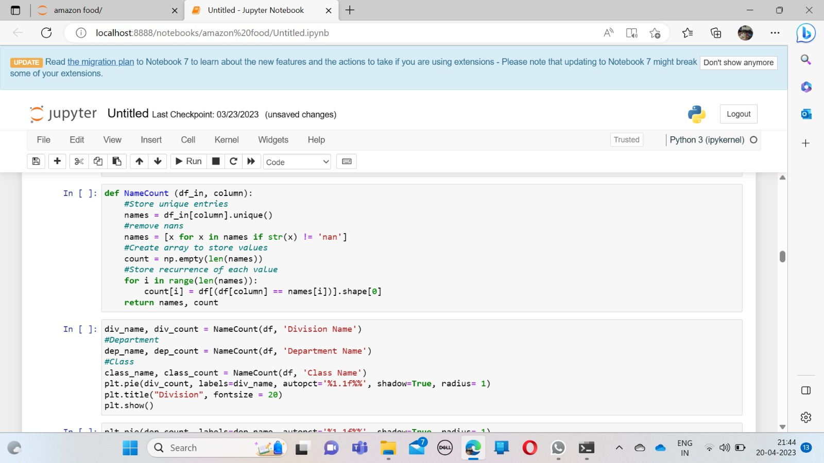
INPUT AND OUTPUT
SCREENSHOTS

Slide 17
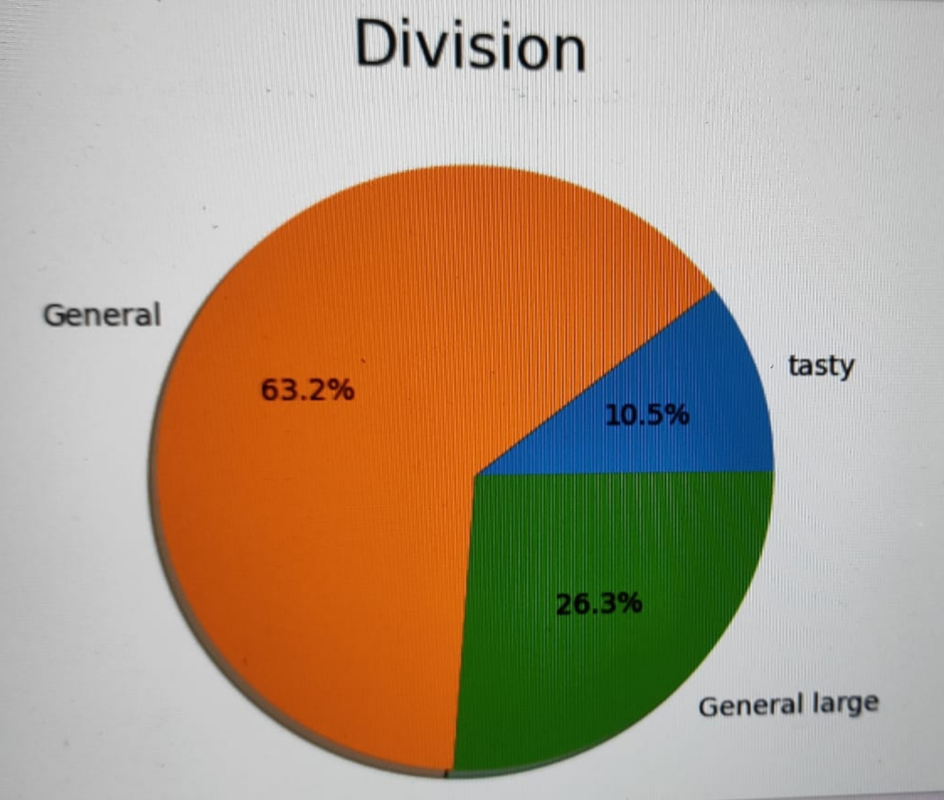
OUTPUT DESIGN

Slide 18
CONCLUSION
This study analyzed Amazon food reviews to gain insights into the affective language used by reviewers, using sentiment analysis to explore the range of emotions that consumers associate with food products.
The results indicate that reviewers use a variety of emotions to describe their food experiences, with positive emotions being the most prevalent. The study highlights the importance of emotional language in shaping consumers' perceptions of food products and stresses the need for businesses to understand the emotional responses of their customers to improve their services and enhance customer satisfaction.
Furthermore, the study identified potential patterns and trends in emotional language across different demographic groups, providing businesses with valuable insights into consumer emotions and preferences.
The study's overall findings contribute to a better understanding of the significance of emotional language for businesses operating in the food industry, and provide actionable insights that can help food businesses improve their products and services, increase customer satisfaction, and strengthen their brand loyalty.

Slide 19
FUTURE ENHANCEMENTS
Future enhancements for emotional examination of Amazon food reviews can in_x0002_clude the use of more advanced NLP techniques and machine learning algorithms toimprove the accuracy and efficiency of emotion detection and categorization.
This can include the use of deep learning models, such as Recurrent Neural Networks(RNNs) and Transformers, which can capture the context and temporal dynamics of emotional expressions in the reviews.
Another potential enhancement can be the integration of other data sources, such as social media and product ratings, to provide a more comprehensive understanding of consumer sentiment and behavior towards food products.
This can also involve the development of predictive models that can forecast consumer behavior and preferences based on emotional analysis and other data sources. Additionally, the emotional examination can be extended to other domains beyond food, such as electronics, fashion, and travel, providing valuable insights into consumer behavior and sentiment in these industries.

Slide 20
REFERENCES
[1] Agarwal, A., Xie, B., Vovsha, I., Rambow, O. and Passonneau, R. (2019). Sentiment Analysis of Twitter Data. Proceedings of the Workshop on Languages in Social Media,30-38.
[2] Cambria, E., Schuller, B., Xia, Y. and Havasi, C. (2018). New Avenues in Opin_x0002_ion Mining and Sentiment Analysis. IEEE Intelligent Systems, 28(2), 15-21.
[3] C. Rain. Sentiment analysis in amazon reviews using probabilistic machine learn_x0002_ing. Swarthmore College, (2019),54-156.
[4] Godes, D., Mayzlin, D. (2018). Using online conversations to study word-of_x0002_mouth communication. Marketing Science, 23(4), 545-560.
[5] H. J. Kim and Y. J. Hyun, "The impact of online reviews on consumer behavior: A model for predicting the volume of online feedback and the valence of reviewer sentiment," Journal of Hospitality & Tourism Research, vol. 35, no. 3, pp. 329-341, 2011.

Slide 21
REFERENCES
[6] Journal of Foodservice Business Research, Taylor Francis, Hoque, M. R., Ka_x0002_mal, M. M., 2018.
[7] Journal of Hospitality Tourism Research, SAGE Publications, Kim, H. J., Hyun, Y. J., 2017.
[8] Kivetz, R., Simonson, I. Earning the right to indulge: Effort as a determinant of customer preferences toward frequency program rewards. Journal of Consumer Research,2015 .
[9] Mohammad, S., Kiritchenko, S. and Zhu, X. (2018). NRC-Canada: Building the State-of-the-Art in Sentiment Analysis of Tweets. Proceedings of the Seventh International Workshop on Semantic Evaluation (SemEval),321-327.
[10] M. R. Hoque and M. M. Kamal, ”Analyzing Emotional Language of Online Reviews to Improve Customer Satisfaction in the Foodservice Industry,” Journal of Foodservice Business Research, vol. 21, no. 4, pp. 346-363, 2018.

Slide 22
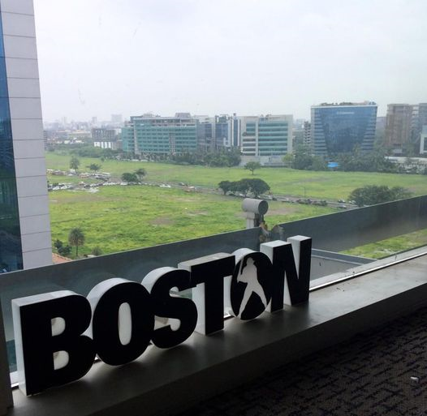
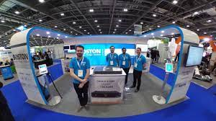
Photos in Industry

Slide 23


